Slide 1
Applications of K-Nearest Neighbor Density Estimation
Isaac Brown

Slide 2
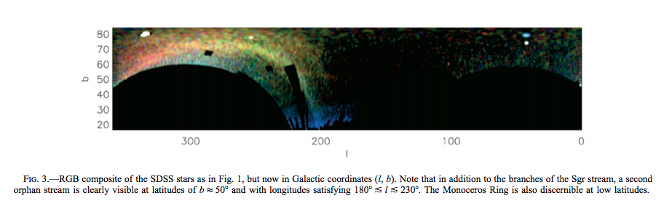
The Field of Streams: Sagittarius and its Siblings
Want to analyze density structure of the SGR Stream

Slide 3
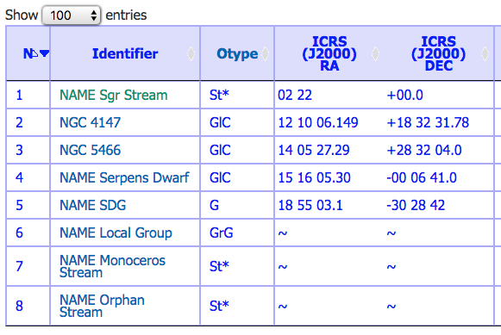
Acquired Data from SIMBAD

Slide 4
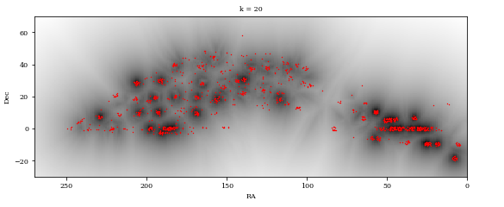
Application of KNN to SIMBAD data

Slide 5
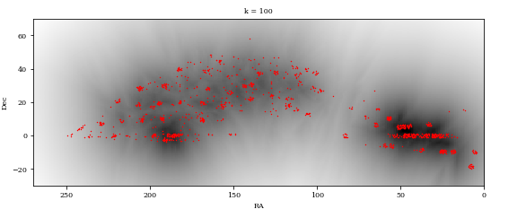
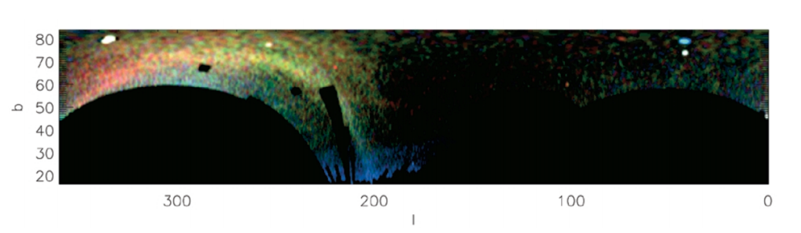
Comparison with Belokurov et. al.

Slide 6
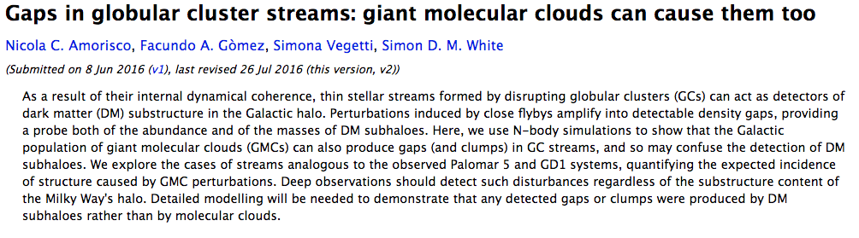
Stellar streams can be interrupted by flyby objects

Slide 7
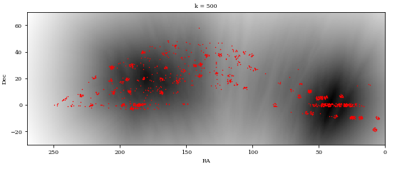
Gap in Stellar Stream

Slide 8
Thank You!

